Slide 1
Capstone Project
CSIS 503 Data Science and Analytics
Summer 2025

Slide 2
Capstone Project Healthcare Spending Impact Analysis: Optimizing Health Investment Strategies Across Africa By: Group 7 (Team: AfriHealth)
CSIS 503 Data Science and Analytics
Summer 2025

Slide 3
Group #7
Team Members
Team member #1 (Jaji, Jimoh – jimoho@osiriuniversity.org)
Team member #2 (Tatenda, Chidewu – tachidewu@osiriuniversity.org)
Team member #3 (Rediet, Tedla – retedia@osiriuniversity.org)
Team member #4 (Njoku, Kingsley – kinjoku@osiriuniversity.org)
Team member #5 (Daniel, Cole Name, – dancole@osiriuniversity.org)
Team member #6 (Fondoh, Peter – pfondoh@osiriuniversity.org)

Slide 4
Table of Contents
Introduction & Objectives
Dataset Description
Methodology
Key Findings and Results
Insights & Recommendations
Limitations
References & Acknowledgements

Slide 5
Introduction & Objective
To analyze how healthcare spending - government, private, out-of-pocket, and external - impacts on health outcomes across African countries, and to identify high-efficiency investment strategies that maximize health gains per dollar spent.
We answer: “Which spending patterns deliver the greatest health impact, and which countries offer scalable models of efficient health system performance?"

Slide 6
Introduction & Objective
The Problem & Relevance
African health systems face limited budgets, high disease burdens, and uneven outcomes.
Not all spending leads to better health — efficiency matters.
Some countries (e.g., Algeria, Cabo Verde) achieve strong outcomes despite moderate spending.
Main Goals:
Quantify the impact of different spending types on health outcomes.
Identify high-efficiency health systems.
Recommend optimal investment strategies for policymakers.
Why This Matters:
Supports UN Sustainable Development Goal 3 and evidence-based health financing.

Slide 7
Dataset Description
We used real-world, open-source data from the World Health Organization (WHO) and the World Bank to build a unified dataset of 1,054 country-year observations across 47 African countries (2000–2022).
This dataset links health financing with health outcomes and socioeconomic context.

Slide 8
Dataset Description
Data Source:
WHO GHED: https://apps.who.int/nha/database
World Bank HNP: https://databank.worldbank.org/source/health-nutrition-and-population-statistics
Size & Structure:
1,054 rows × 22 columns
47 African countries, 2000–2022
Key Variables:
CHE_GDP, GGHE_pct_GDP, OOP_pct_CHE
Life_Expectancy, Infant_Mortality, DPT_Immunization
Population, GDP_per_capita
Preprocessing:
Merged 12 WHO indicators
Standardized country names
Applied Weighted Mean 66POP for regional aggregation
No imputation — missing data handled per World Bank rules

Slide 9
Methodology
Overview of Analysis Process
We followed a structured data science pipeline:
Data Acquisition → WHO + World Bank
Cleaning & Merging → Unified african_health_spending_outcomes.csv
Exploratory Data Analysis (EDA) → Trends, correlations, visualizations
Modeling → Linear regression to predict life expectancy
Efficiency Analysis → Residuals = Actual − Predicted
Regional Aggregation → Using Weighted Mean 66POP
Policy Recommendations → Actionable insights

Slide 10
Methodology
Techniques & Tools
EDA Techniques:
Correlation matrices
Scatter plots, bar charts, time trends
Efficiency ranking
Tools & Libraries:
Python: pandas, numpy, scikit-learn, matplotlib, seaborn
Jupyter Notebook
Why These Methods?
Regression isolates spending impacts
Efficiency scoring identifies high-performing systems
Weighted Mean 66POP ensures robust regional summaries
Aggregation Rule:
"Aggregates are calculated as weighted averages of available data. No aggregate is shown if countries with missing data represent more than one third of the total population of the custom group." — Weighted Mean 66POP, per World Bank methodology

Slide 11
Key Findings & Results
Key Insights at a Glance
The model explains 24.3% of variation in life expectancy (R² = 0.243).
Algeria and Cabo Verde are the most efficient health systems.
Southern Africa spends the most but has lower life expectancy than East Africa.
DPT Immunization is the strongest positive predictor of longevity.
Government spending shows a negative coefficient — likely due to reverse causality.

Slide 12
Summary of Findings & Results
Major Trends & Visuals
📊 Top 10 Most Efficient Health Systems
(Efficiency Score = Actual − Predicted Life Expectancy)
Rank | Country | Efficiency Score (Years)
1 | Algeria | +11.31
2 | Cabo Verde | +10.36
3 | Mauritania | +6.33
4 | Ethiopia | +6.32
5 | Madagascar | +5.99
6 | Gabon | +5.44
7 | Angola | +3.84
8 | Mauritius | +3.64
9 | São Tome and Principe | +3.39
10 | Senegal | +3.11
📈 Algeria achieves over 11 years more than predicted by its spending.

Slide 13
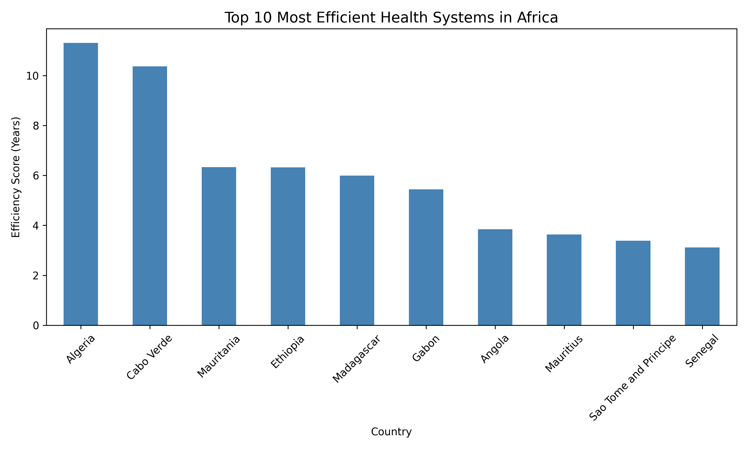
Summary of Findings & Results
📊 Top 10 Most Efficient Health Systems
(Efficiency Score = Actual − Predicted Life Expectancy)
📈 Algeria achieves over 11 years more than predicted by its spending.

Slide 14
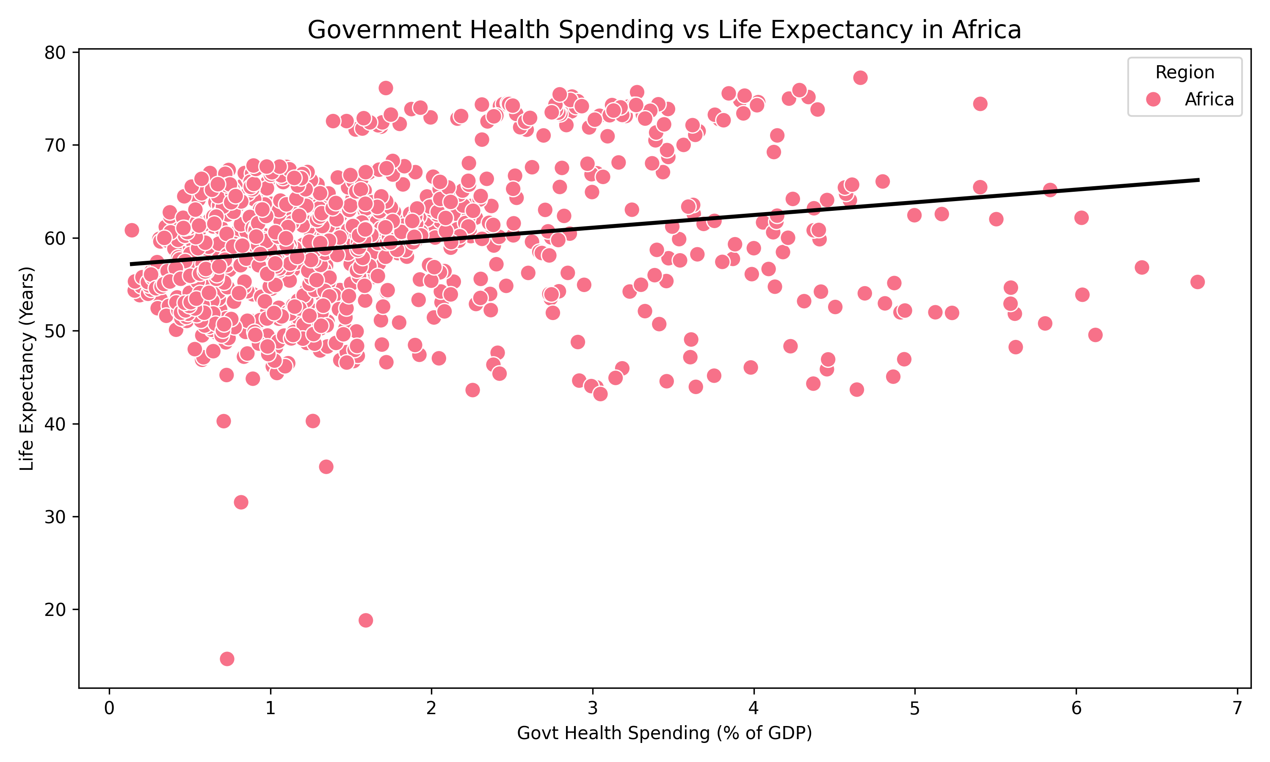
Summary of Findings & Results
📊 Government Health Spending Vs Life Expectancy
📈 Algeria achieves over 11 years more than predicted by its spending.

Slide 15
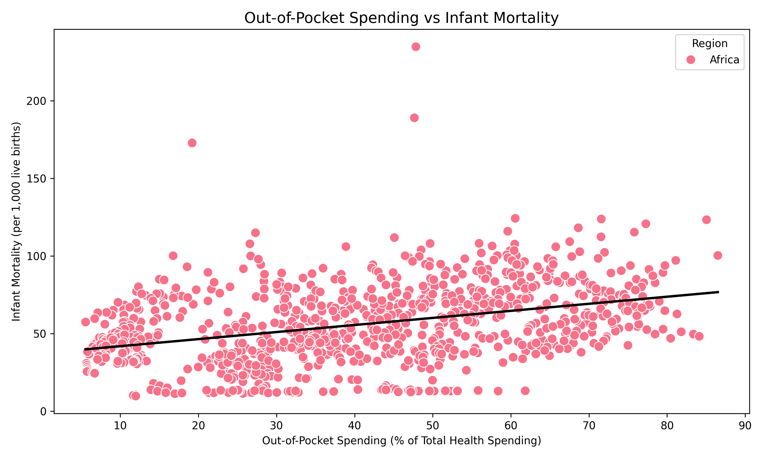
Summary of Findings & Results
📊 Out-of-Pocket Spending vs Infant Mortality
📈 Algeria achieves over 11 years more than predicted by its spending.

Slide 16
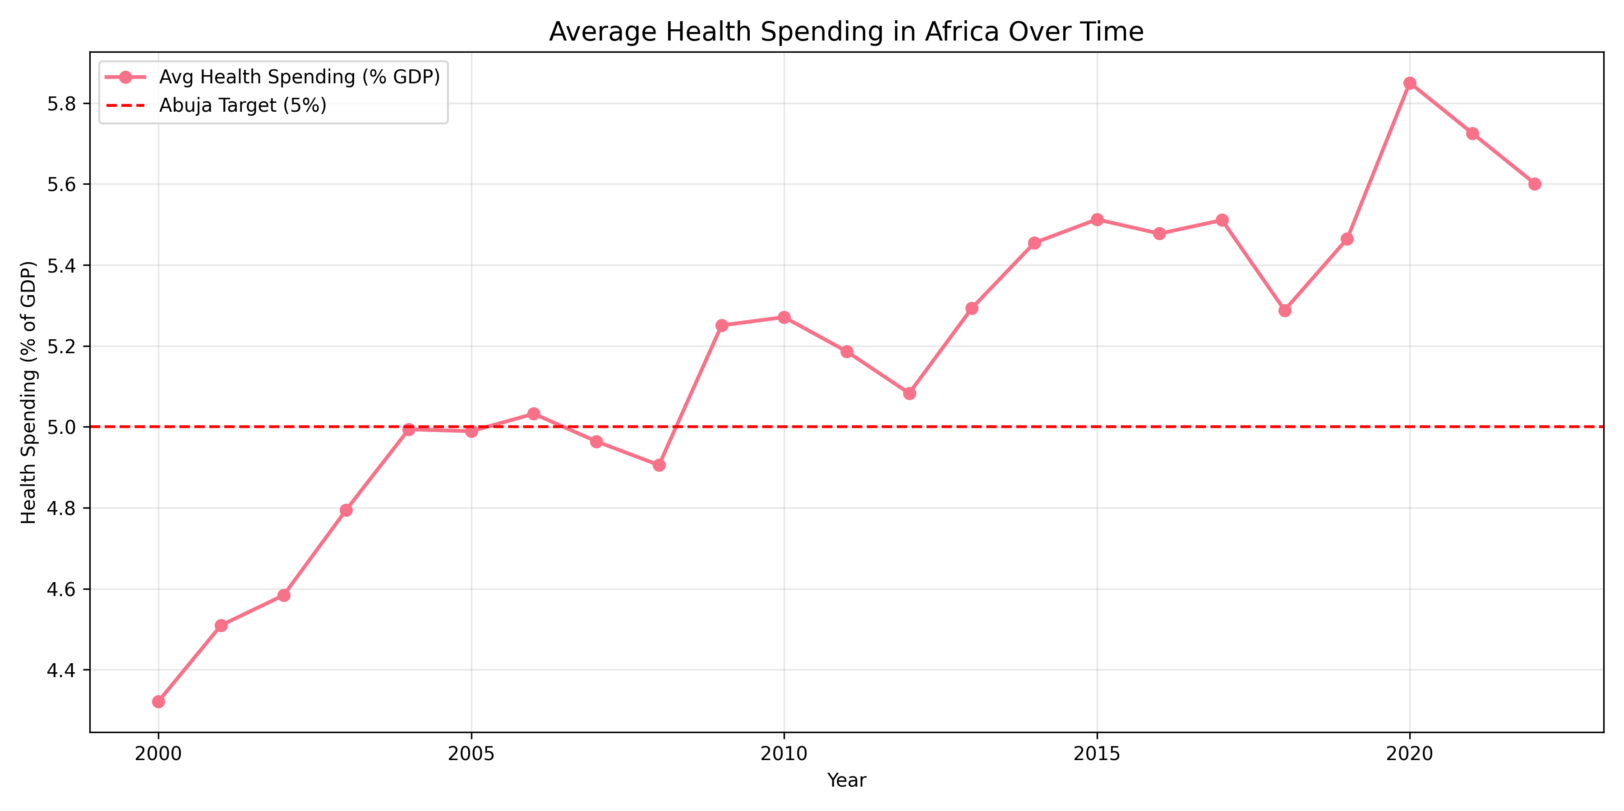
Summary of Findings & Results
📊 Average Health Spending in Africa Over Time

Slide 17
Summary of Findings & Results
📊 Regional Trends (2020, Weighted Mean 66POP)
Region | Life Expectancy | CHE (% GDP)
North Africa | 73.3 | 5.60%
Southern Africa | 64.7 | 8.40%
East Africa | 64.8 | 4.10%
West Africa | 55.4 | 3.60%
Central Africa | 62.1 | 4.20%
📉 Southern Africa spends the most but underperforms — likely due to HIV and inequality.
Model Performance:
R² = 0.243
RMSE = 5.57 years

Slide 18
Insights & Recommendations
Summary of Insights
Efficiency > Spending: Algeria and Cabo Verde prove that smart investment beats high spending.
Prevention Works: DPT Immunization has the strongest positive effect (+0.225 years per 1% increase).
High OOP Harms Equity: Out-of-pocket spending reduces access and financial protection.
Reverse Causality: High government spending correlates with lower life expectancy — likely because sick populations require more spending.
Southern Africa Paradox: High spending ≠ high outcomes — structural challenges reduce impact.

Slide 19
Insights & Recommendations
Policy Actions
Learn from High-Efficiency Countries Scale models like Algeria’s universal coverage and Cabo Verde’s primary care system.
Invest in Prevention Expand immunization, maternal care, and disease surveillance.
Reduce Out-of-Pocket Payments Move toward universal health coverage (UHC) to protect households.
Improve Data Quality Strengthen national health accounts for better monitoring.
Use Weighted Mean 66POP For all regional reporting — ensures robustness and transparency..
💡 These actions can help countries get more health per dollar!.

Slide 20
Limitations
Summary of Limitations
The model explains only 24.3% of variation — many factors (governance, equity, disease burden) are not captured.
Negative coefficient on government spending may reflect reverse causality, not inefficiency.
Data gaps: Some countries have missing years, especially before 2010.
No imputation: Aggregates are approximations — missing data not filled in.

Slide 21
Limitations
Detailed Constraints
Data Quality & Size:
Some countries have sparse data (e.g. Central Africa Republic)
Pre-2010 data is limited
Assumptions Made:
Linear relationship between spending and outcomes
No interaction effects modeled
Model Limitations:
R² = 0.243 indicates modest explanatory power
Causality cannot be inferred — only correlation
⚠️ Results should be treated as approximations, not exact totals.

Slide 22
References & Acknowledgements
Sources & Credits
Data Sources:
World Health Organization. (2024). Global Health Expenditure Database. https://apps.who.int/nha/database
World Bank. (2024). Health, Nutrition and Population Statistics. https://databank.worldbank.org/source/health-nutrition-and-population-statistics
World Bank. (2024). Aggregation Rules Documentation. https://databank.worldbank.org/source/health-nutrition-and-population-statistics?spm=a2ty_o01.29997173.0.0.56f65171sgIC6Q
Tools Used:
Python (pandas, scikit-learn, matplotlib, seaborn)

Slide 23
References & Acknowledgements
Team Members
Jaji Jimoh Oludare : Data Wrangler
Chidewu Tatenda: EDA Lead
Rediet Tedla: Modeling Lead
Daniel Cole : Visualizer
Kingsley Njoku: Storyteller & Presenter

